Slide 1



AI-Powered Corporate Wellness Platform
Helping Employees Achieve Health, Balance & Team Engagement

Slide 2

AGENDA
1
Problem Statement
2
Why It Matters?
Our Solution – Website Overview
3
4
Data Sources / APIs

Slide 3

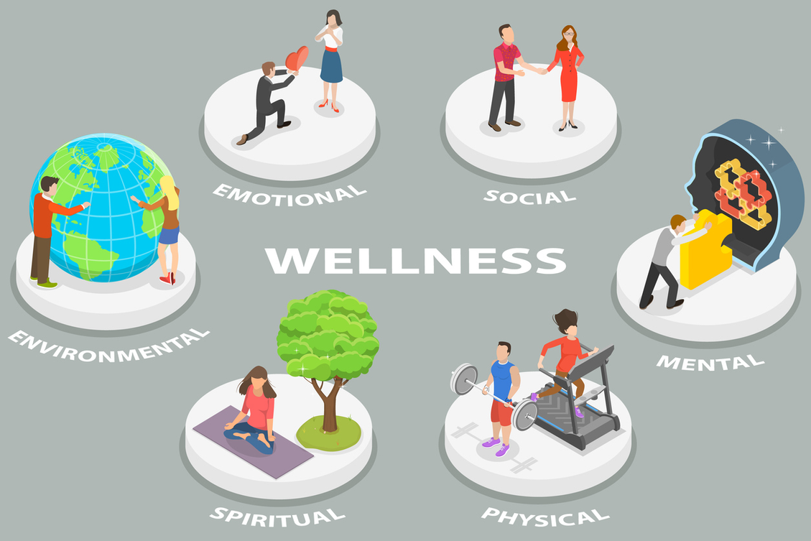

PROBLEM STATEMENT
Many employees struggle to stay active, especially in hybrid work environments. Our platform helps tackle this

Slide 4

WHY IT MATTERS ?

Slide 5



We built a website that encourages friendly competition among coworkers by tracking steps and showing progress

Slide 6

IDEA
Set wellness goals
Track progress via wearables
Engage in team challenges
.

Slide 7

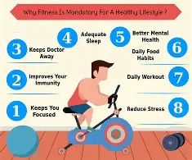
OUR OVERVIEW
Employees who stay active are healthier, happier, and more productive. Even simple walking challenges can make a big difference.
Nutrition
Fuels energy, improves mood and focus

Slide 8

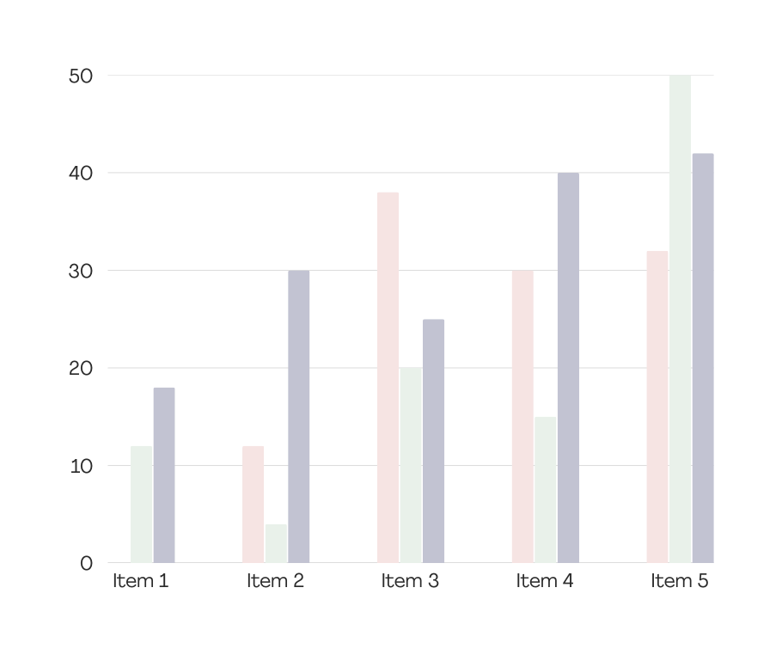
EMPLOYEES WELLNESS TRACKING

Slide 9
FUTURE PLAN
In the future, we aim to integrate real fitness and health APIs to provide live tracking.
We’ll add personal goal-setting, gamify the experience with rewards, and even launch a mobile app.

Slide 10

CONCLUSION
Our platform promotes health, connection, and fun — all at work

Slide 11
QUESTIONS?

Slide 12

Thank you!

